Slide 1
DATA ANALYTICS PROJECT.
Presented by,
Tumusiime Arnold
Muyanja Rodney
Tusiime Allan
Shyaka Stephen

Slide 2
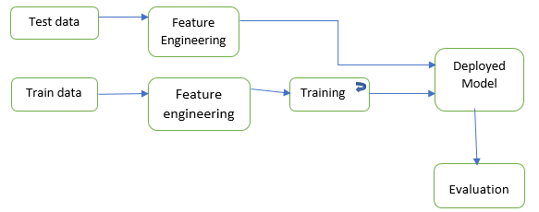
PROJECT CONCEPT
This project is based on a Fraud detection dataset obtained from Kaggle.com. Our Main aim is to create a data pipeline that consists of the following key aspects;
Data Loading.
Data Wrangling.
Data Visualization.

Slide 3
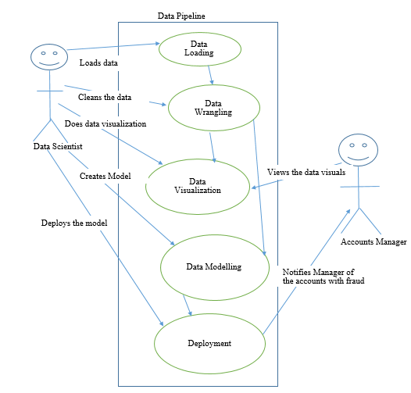
REQUIREMENTS SPECIFICATION
Here we describe the use cases for our data analytics pipeline. This includes the actors in the use case diagram and the use cases.

Slide 4
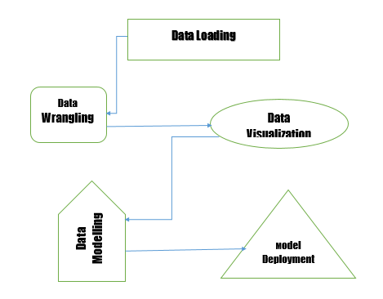
SYSTEM DESIGN SPECIFICATION
Here we describe the key components in the data pipeline, what they are, what they do and how they do it.

Slide 5
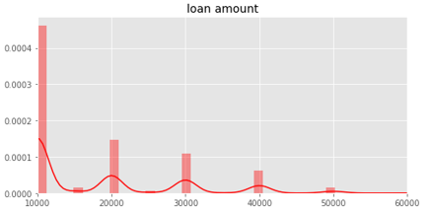
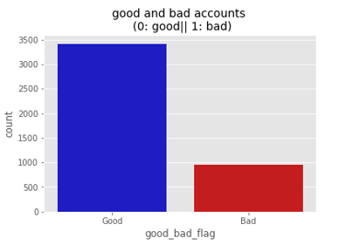
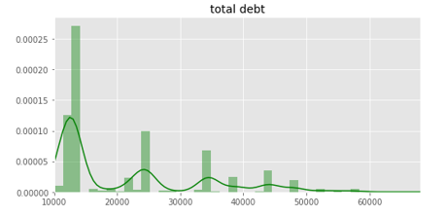
IMPLEMENTATION REPORT
Here we describe visualizations created from our dataset and come up with recommendations to the various stake holders. Below are the created visuals.

Slide 6
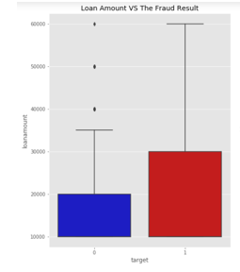
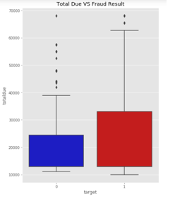
More analysis visuals

